Slide 1
Tools for Agile Development
Day 5

Slide 2
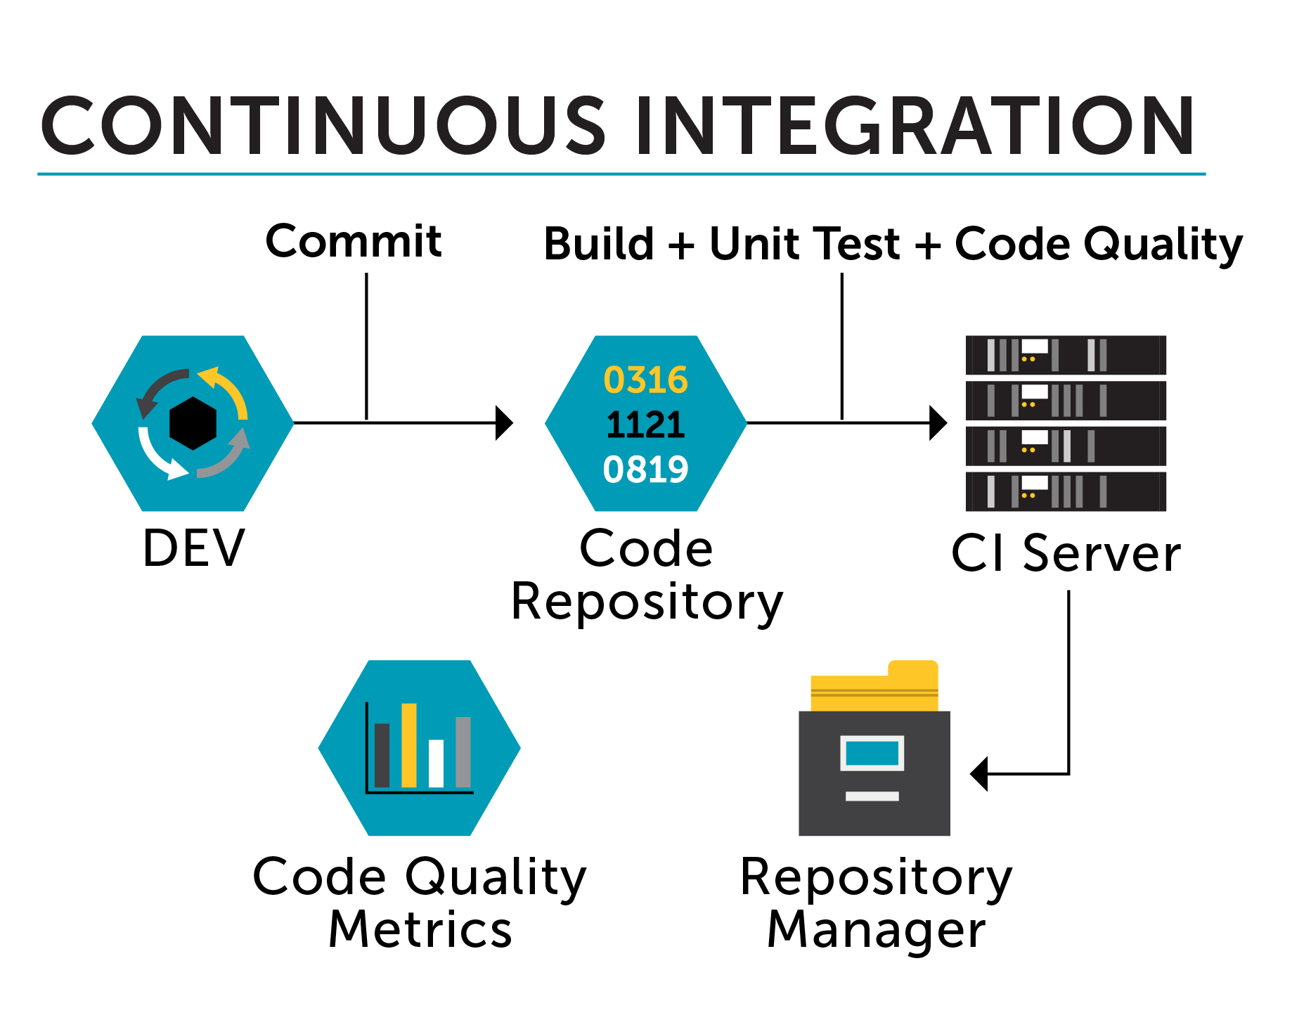
CI/CD

Slide 3
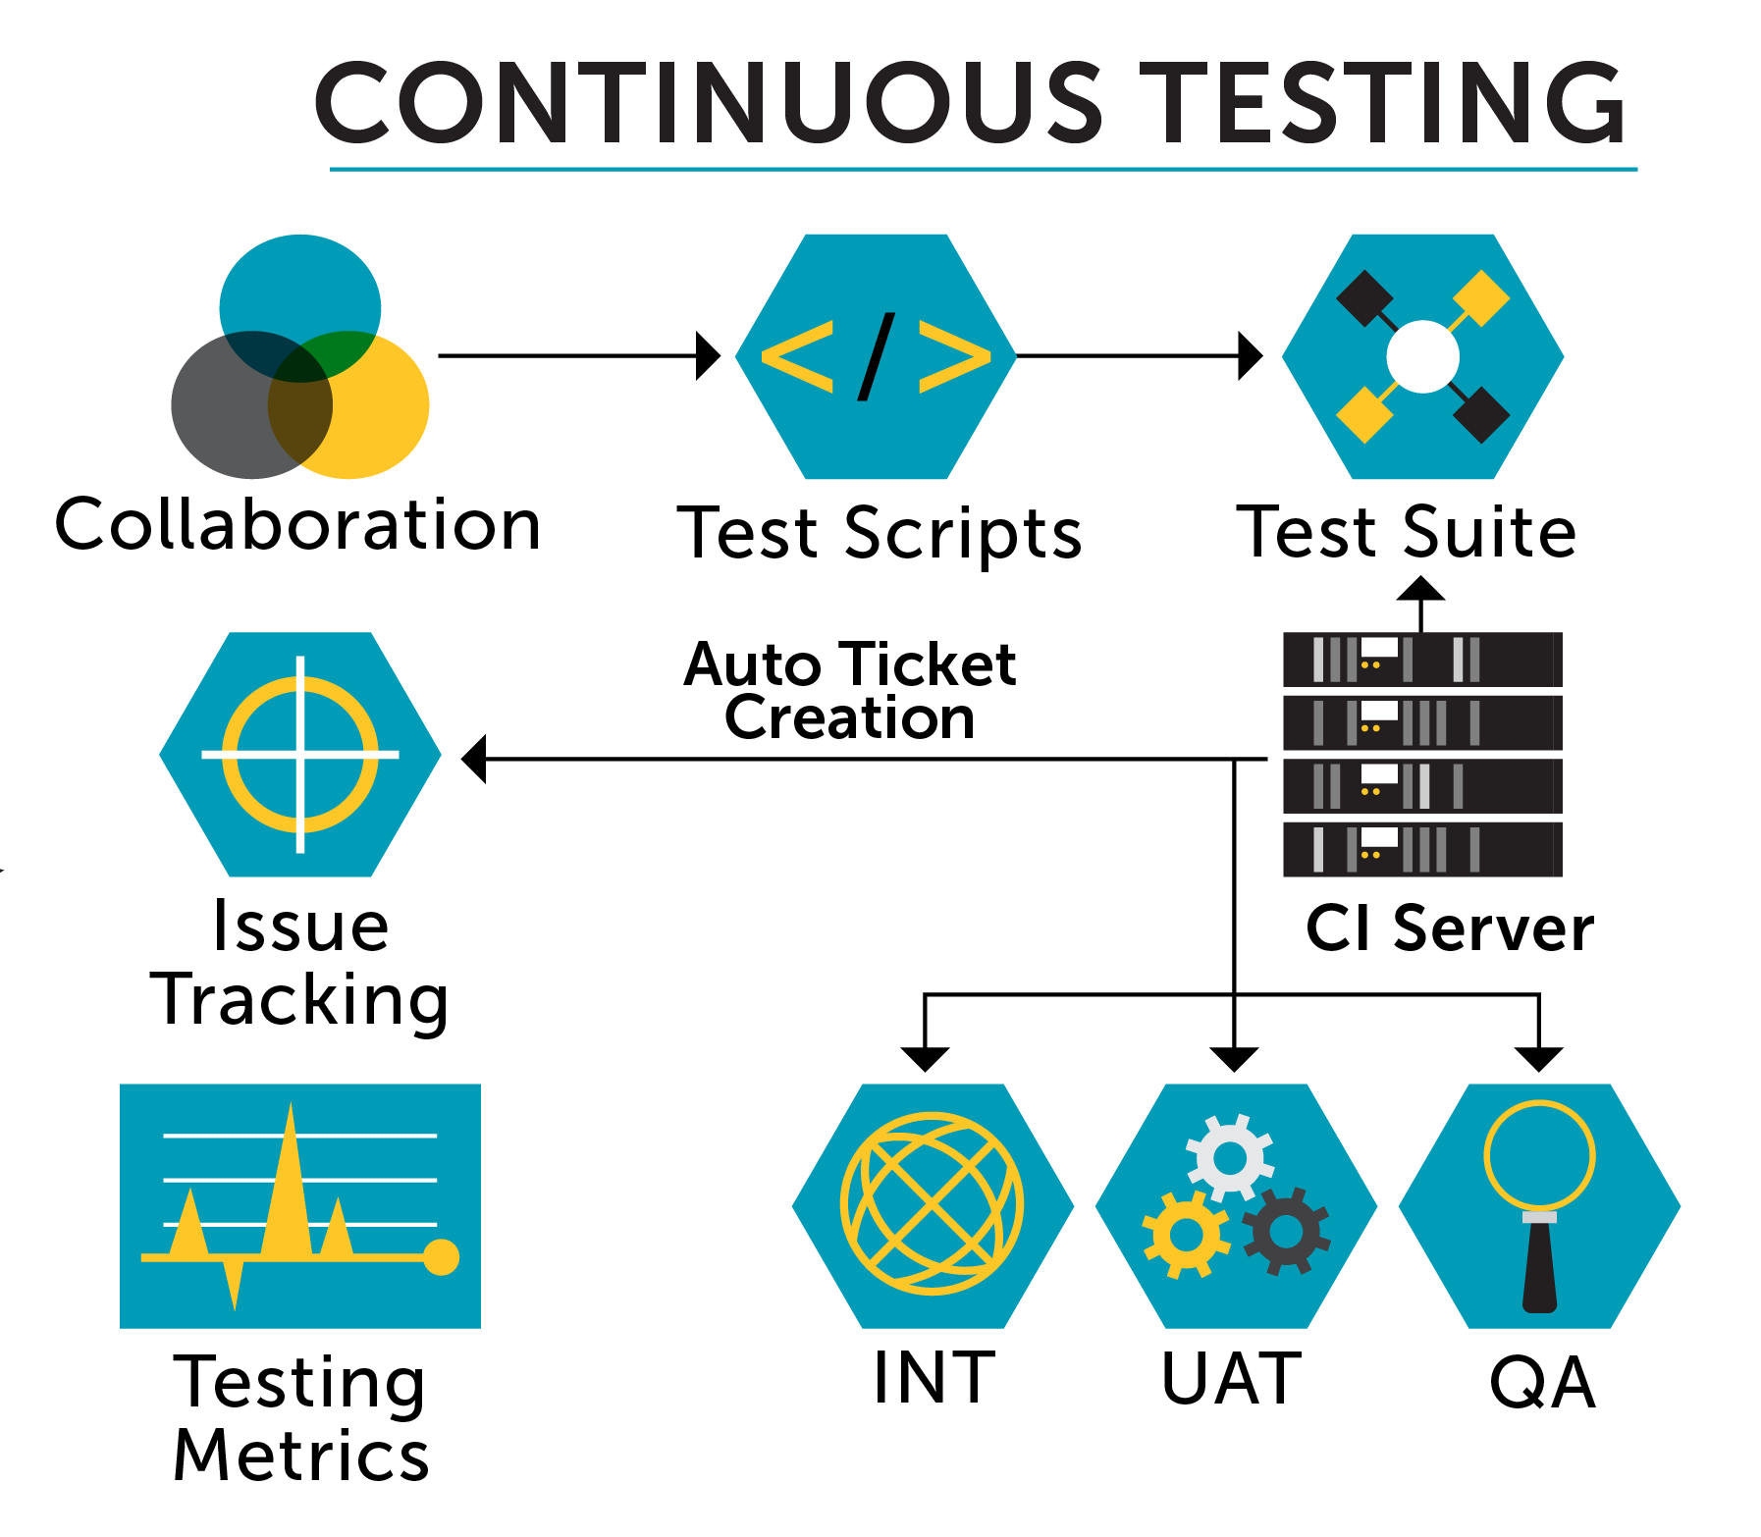
CI/CD

Slide 4
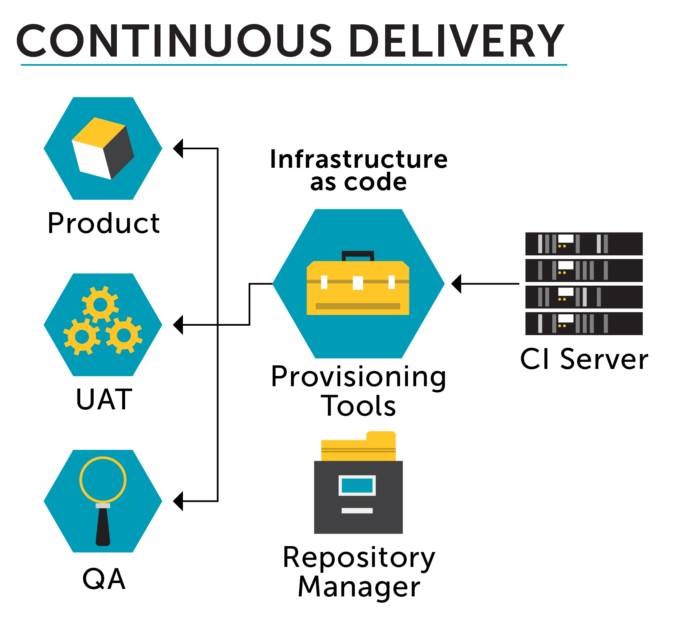
CI/CD

Slide 5

CI/CD
Notes:
Build
Tag
Login
Push

Slide 6
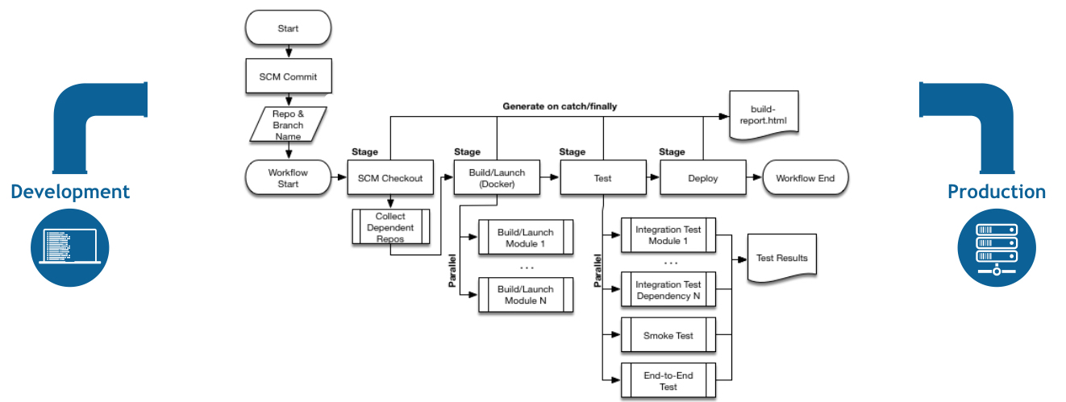
CI/CD
Notes:
Build
Tag
Login
Push

Slide 7
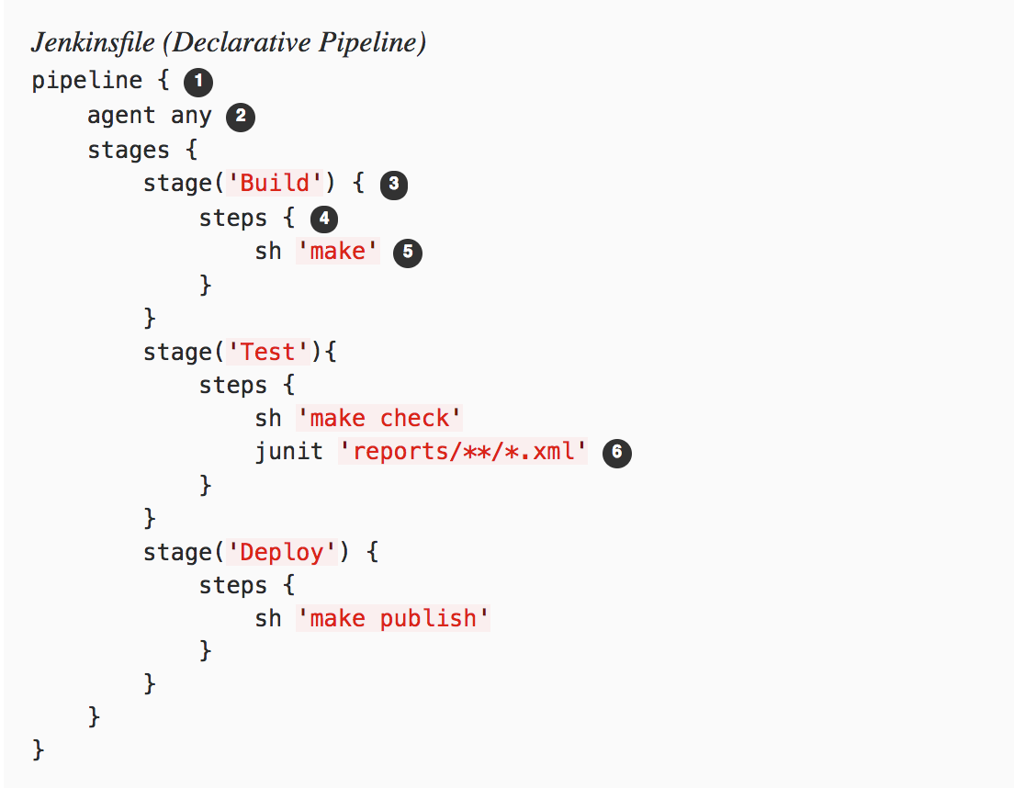
CI/CD
Notes:
Build
Tag
Login
Push

